Slide 1
OFFER/Salary negotiations
Diane Riemer
Career Coach

Slide 2
Why are we here?
aGENDA
Negotiation basics
Start thinking about what you want in the job offer you accept
Ok, so how do I actually do this?

Slide 3
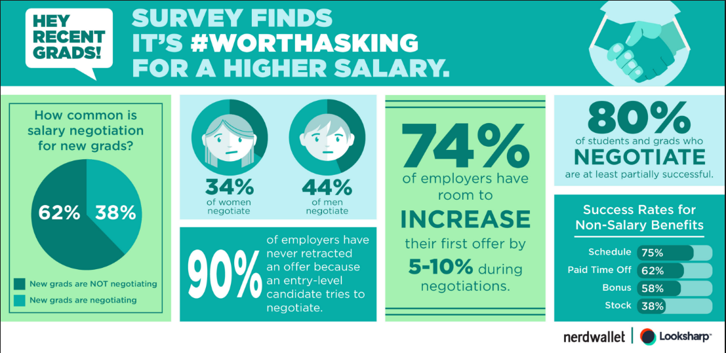
WE ARE aLSO HERE BECAUSE…
AGENDA

Slide 4
The basics
SALARY NEGOTIATIONS

Slide 5
STRATEGY
THE BASICS
  Attitude
      Win/Win – 2 people solving a problem together
      Enthusiasm and gratitude
      Confidence
  Be Ready!
      Thinking, research, planning
  Negotiating Vocabulary
      “we”; “open”; “flexibility”; “the firm”
      Your negotiation is a sneak preview!

Slide 6

BE READY!
THE BASICS
What is the going rate for the position you are being offered?
How do your credentials compare to the job requirements?
Do you have any “extras” that differentiate you? Do they differentiate you without exceeding the job requirements?

Slide 7


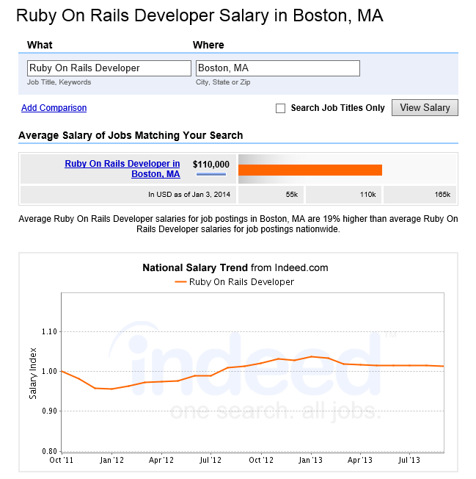




Be READY

Slide 8
Be ready
The basics
What do you want from your next position?
What does your dream job/company look like?
What is the perfect role for you?
What are your “Must Haves/Nice to Haves”
What is your ideal salary? How far from the actual salary offer can you go?
What is your “walk-away” number?

Slide 9
Plan the negotiation
BE READY
Make a matrix of their requirements and your qualifications
Add your “extras” and describe how they benefit this firm
Review your “Must haves/Nice to haves”
  Decide what you can trade off
Examine what other prospects are in your pipeline
Be sure you understand what is not negotiable
Write out your best case scenario
Confirm your walkaway number
Role play the conversation if possible

Slide 10
WHAT’S NEGOTIABLE
Non-Negotiable (Public companies) | Negotiable | May be Negotiable
401K | Salary | Professional Development
Health Care Plan | Relocation | Special Hardware/Software
HCRA/DCRA | Start Date | Flextime
Company PTO Schedule | Title | Vacation Time
HR Policy Related Issues | Vacation, time off for pre-existing commitments | Tablets, laptops, cellphone
Profit Sharing Plans |  | Technical journals, publications, memberships
Stock Grants (public companies) |  | Conferences
Expense Reimbursement Terms |  | 1st Salary Review (out of phase)
Subsidized transportation passes |  | NDA – non-compete

Slide 11
OFFER PROCESS
The basics
  Email, voicemail with initial offer
  Defer accepting on the spot
      Request a follow up call/meeting within the next day or two
      Clarify the offer process – verbal or written
      Once its in writing, its very, very hard to modify the offer terms
  Get the final offer in writing (hard or soft copy)
      Be sure it matches what you have agreed to
      Sign, copy and return by required date

Slide 12
THINGS THAT PROBABLY WON’T FLY
THE BASICS
Negotiating if you don’t intend to accept an offer
Asking for salary that is significantly more than what is offered
Justifications that don’t align with the firm’s needs
      “I need more money”
      “My friend got an offer for this kind of position, but with more money”
Trying to leverage the negotiation with a fake job offer
Negotiating a “best and final” written offer
Reneging once you have accepted

Slide 13
Okay…so how do I actually do this?
SALARY NEGOTIATIONS

Slide 14
First steps
How do I actually do this?
Schedule the meeting
Organize your list of “must haves” leaving salary as the final point to discuss
Gather your extras, tradeoffs, research, your qualifications vs. job requirements
Practice your talking points out loud in front of a mirror

Slide 15
The Conversation
How DO I ACtUALLY DO THIS
It’s your meeting – own it!
Review items that are in the offer that you agree with (benefits, start date, title, reporting to)
Discuss “must haves” starting with the least important
Summarize what you have both agreed to so far

Slide 16
Negotiating the salary
How do I actually do this?
“The last thing I would like to discuss is salary. I see that you are offering a salary of $35,000. I had a different number in mind, does the firm have any flexibility on that?”
“I was thinking of something in the upper 60s – here’s why……..”
Confirm next steps
  Written or verbal offer?
  Clarify at what point the negotiations are considered over

Slide 17
The offer!
SO HOW DO I ACTUALLY DO THIS?
Ask that the verbal offer be confirmed in writing (email or snail) “just to be sure I haven’t misunderstood anything”
  Not legally binding (on either side)
  Verify all negotiated points to be sure the offer is consistent with your expectations
  Verify start date, title, supervisor, salary, etc.

Slide 18
YOUR TURN
Negotiation role play
SALARY NEGOTIATIONS

Slide 19
What if they Can’t improve the salary?
How do I actually do this?
  “I understand, thank you for considering my request”
  “Would the firm be open to an out-of-phase performance and salary review?”

Slide 20
MuLTiPle OpportunitIes
Managing Offers
Timing
  “As you can imagine, I am in an active job search right now; I feel as though one of the opportunities is getting to close to an offer, could you share with me where you are in the process”
Choosing
  Is this your dream company?
  Is this the perfect role for you?
  What is your ideal offer? Is this it?
  Which will get you to your next step?

Slide 21
LevEraging REAL Offers
Managing Offers
“Just checking in to see where the firm is in the process. I want you to know I have an offer from another firm and I have been asked to respond right away. You are my top choice because xxx, xxx, and xxxx. Could you share with me your timetable for making a decision.”
What if their timetable and yours don’t match?

Slide 22
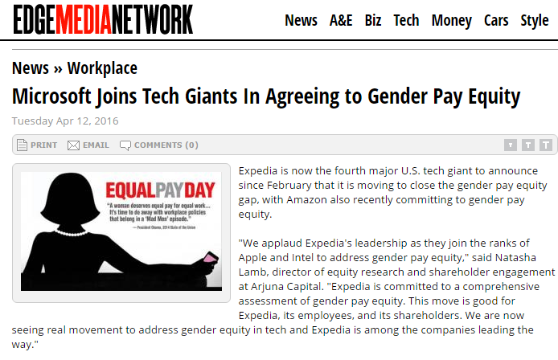
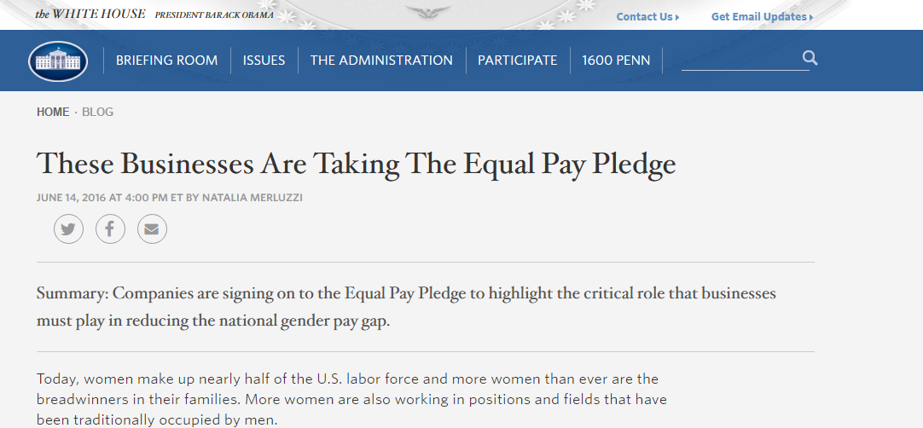
SALARY EQUiTY
Salesforce, Spotify, Airbnb, Amazon, Cisco, Expedia, Glassdoor, GoDaddy, Pinterest

